Slide 1
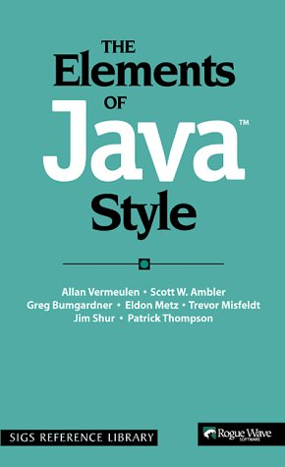

Style Rules II:
Names and Naming

Slide 2
Overview
Today we will discuss:
  Reasons for naming conventions
  Rules for naming variables, classes, and methods

Slide 3
Why have naming conventions?
A program is written once, but read many times
  During debugging
  When adding to the program
  When updating the program
  When trying to understand the program
Anything that makes a program more readable and understandable saves lots of time, even in the short run

Slide 4
Rule 9:Use meaningful names
Names should be chosen very carefully, to indicate the purpose of a variable or method
If the purpose changes, the variable or method should be renamed
It is worthwhile spending a little time choosing the best name
Long, multiword names are common in Java

Slide 5
Rule 10: Use familiar names
Where common terminology exists, use it; don’t make up your own
Example from the book: If your users refer to “customers,” your program should use the name Customer, not Client

Slide 6
Rule 11: Question excessively long names
Variables should be used for a single purpose
Methods should do one simple, clearly defined thing
If a descriptive name is overly long, maybe the variable or method is trying to serve too many purposes

Slide 7
Meaningful names: exceptions I
It is common practice to use i as the index of a for-loop, j as the index of an inner loop, and k as the index of a third-level loop
This is almost always better than trying to come up with a meaningful name
Example:
  for (int i = 1; i <= 10; i++) {
  for (int j = 1, j <= 10; j++) {
  System.out.println(" " + (i * j));
  }
  }

Slide 8
Meaningful names: exceptions II
Method variables may be given short, simple names, IF:
  The purpose of the variable is obvious from context, and
  The variable is used only briefly, in a small part of the program
But never use non-meaningful names for class or instance variables

Slide 9
Rule 28: Use standard names for “throwaway” variables
If variables have no special meaning, you can use names that reflect their types
  For example, if you are writing a general method to work with any strings, you might name them string1, string2, etc.
Alternatively, you can use very short names
  s, t, u, or s1, s2, etc. are often used for Strings
  p, q, r, s are often used for booleans
  w, x, y, z are often used for real numbers

Slide 10
Rule 12: Join the vowel generation
Despite the cutesy name, this rule is important
In more primitive languages, names were often limited to 8 or so characters
  This led to names like maxVolum and lngPlyng
  The usual rule was to leave out vowels, starting from the right
  Such names are harder to read and to remember
Do not leave out vowels, or otherwise use unusual abbreviations, in Java!

Slide 11
Naming classes
Rule 18: Capitalize the first letter of each word, including the first:
PrintStream, Person, ExemptEmployee
Rule 19: Use nouns to name classes:
ExemptEmployee, CustomerAccount
  Classes are supposed to represent things

Slide 12
Naming variables
Rule 25: Capitalize the first letter of each word except the first:
total, maxValue
Rule 26: Use nouns to name variables:
balance, outputLine
  Variables are supposed to represent values

Slide 13
Naming methods
Rule 22: Capitalize the first letter of each word except the first:
display, displayImage
  Methods are capitalized the same as variables
Rule 23: Use verbs when naming methods:
displayImage, computeBalance
  Methods are supposed to do something

Slide 14
Rule 13: Capitalize only the first letter in acronyms
In names, write acronyms such as GUI and API as Gui and Api
Examples: setDstOffset, displayAsHtml, loadXmlDocument
Since capital letters are used to separate names, this rule helps avoid confusion

Slide 15
Naming constants
A constant is an identifier whose value, once given, cannot be changed
Constants are written with the keyword final, for example:
  final int FIVE = 5;
  final float AVOGADROS_NUMBER = 6.022E23;
Rule 31: Constants are written in ALL_CAPITALS, with underscores between words
Exception: color names, such as Color.pink
  Colors were defined before conventions were established
  However, Java 1.4 adds properly capitalized names for colors, such as Color.PINK

Slide 16
Will you be held responsible for following these rules?
Yes

Slide 17
The End

